Slide 1
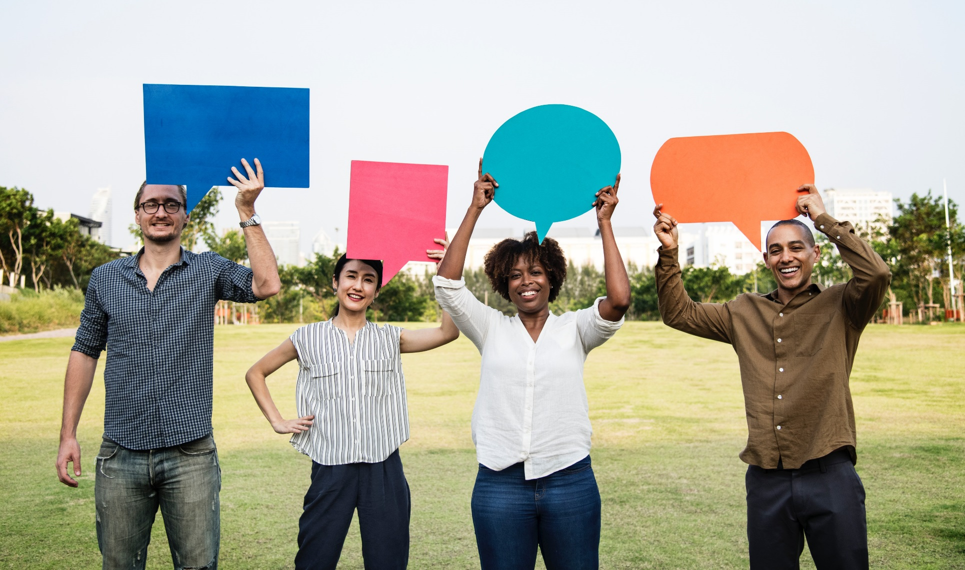
Afro Afroamerikaner antworten asiatisch by rawpixel.com / licensed CC0
Intercultural Acting

Slide 2
Agenda
Learning Goals
Warm-up: What is Intercultural Acting and why do we need to study it?
Culture and Communication
Approaches to Intercultural Communication
Get a Grip on the Language
Politeness in Different Cultures
Language and Politeness

Slide 3
1. Learning goals
At the end of this unit you will:
… have reflected about your own linguistic and pragmatic behavioural norms and will get to know areas of potential differences in target country
… know essential terms of successful intercultural communication
… know strategies for dealing with uncertain situations
… be able to use meta-communicational and cultural skills to negotiate and mediate in intercultural conflict situations

Slide 4
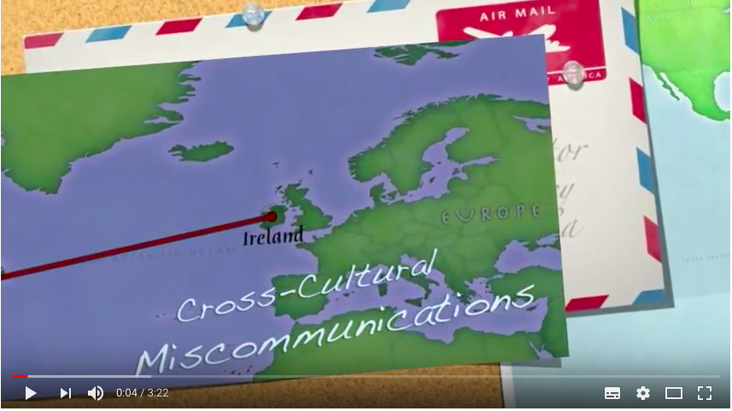
2. Warm-up
Cross-cultural miscommunications
https://www.youtube.com/watch?v=ebRQQwzRo1o
Share your own experiences of difficult cultural encounters (e.g. misunderstandings) and other situations of uncertainty
What were possible reasons for conflicts/misunderstandings?
What did you do/what would be possible strategies to resolve these conflict situations?

Slide 5
3. Culture and Communication
Anna Wierzbicka, about her own experience as a Pole living in Australia:
‘I had to start learning new "cultural scripts"...and... I became aware of the old "cultural scripts"....I also became aware...of the reality of "cultural scripts" and their importance to the way one lives one's life, to the image one projects, and even to one's personal identity’ (Wierzbicka 2003: x)
Notes:
Wierzbicka says about her work that it is rooted in her own experiences as a “language migrant” from a Polish to an English-speaking context (Australia). She has been living in Australia for almost 40 years now, but in many publications she talks about her first years in Australia as a time when she had to learn new cultural scripts of communication: for example: when she called her mum she used to shout a lot on the phone (expressing excitement), and her Australian husband used to signal to her that she should talk lower; or: she used to use the phrase ‘of course’ a lot, and her husband pointed out that this sounds very foreign and may be related to the Polish cultural ways of speaking.

Slide 6
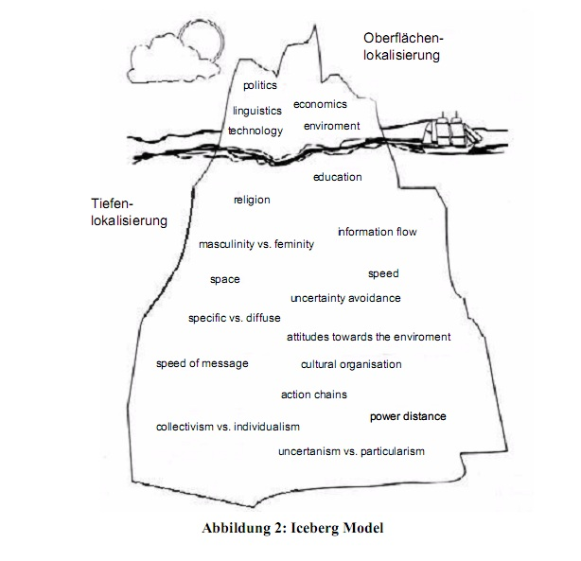
Visible culture
Invisible, under the surface (beliefs, values, worldview)
Iceberg Modell on https://commons.wikimedia.org/wiki/File:IceBergModell.jpg licensed by Wikipedia Commons
Notes:
Advisers: make sure you tell the students that this is only one way to look at it

Slide 7
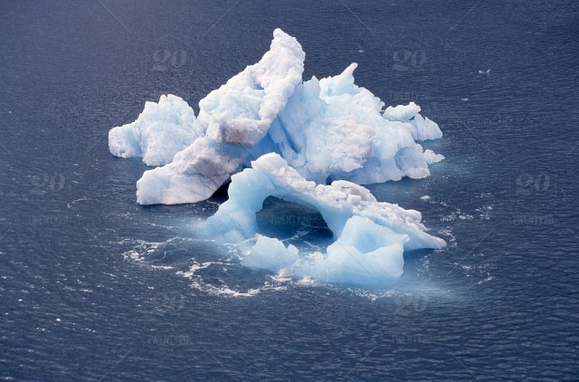
When Icebergs Collide
If we know their values we can explain their behavior.
If we don’t know their values and their behavior is different from ours, we often describe it both SUBJECTIVELY and NEGATIVELY
Photo by JBL / licensed Royalty-Free

Slide 8
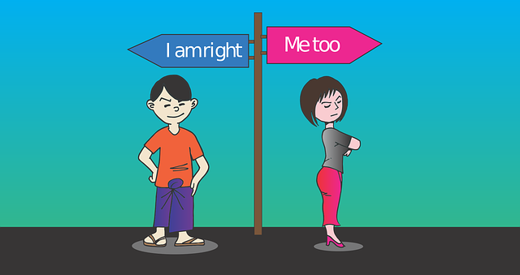
Breakdown of Communication
We are social animals
When communication breaks down we experience pain and frustration
In a cross-cultural encounter, communication may break down because of different communicative habits
Photo by MoteOo / licensed CC0

Slide 9
Definitions
What is an intercultural situation?
What is intercultural competence?
Developing behaviour to communicate effectively and appropriately in a situation where people of different cultural backgrounds come together. It also includes thought patterns and non-verbal behaviour.
We construct communicative situations by making different choices of behaviours

Slide 10
Defining intercultural communication
Intercultural communication aims at understanding the extent to which non-shared knowledge affects and modifies the retrieval of intended meaning
Mismatches
Intention and interpretation
Limited mutual understandings
Cultural biases

Slide 11
Why do we need to study Intercultural Communication?
Watch this TedX Talk by Pellegrino Riccardi on Cross-cultural Communication:
https://www.youtube.com/watch?v=YMyofREc5Jk&spfreload=10
“…individuals from different societies or communities carry out their interactions (whether spoken or written) according to their own rules or norms, often resulting in a clash of expectations and, ultimately, misperceptions about the other group. The misperceptions are typically two-way; that is, each group misperceives the other.” (Boxer 2002: 151)
Different rules of speaking have the potential to cause stereotypes, prejudices, discrimination against entire groups of people
Cross-cultural interaction is the norm across societies and within them

Slide 12
Discomfort & cultural differences (1)
Why doesn’t he/she just say yes or no?
In one culture, an indirect signal may signal indecisiveness, while in another culture it signals deference & respect.
Why is he/she always staring at me?
In one culture staring can signal aggressiveness or intimidation, while in another culture direct eye contact shows attention & esteem.
Why does he/she have to be right in my face whenever he/she talks to me?
In one culture the range of personal space can be much smaller than in another culture.
Source: CCL, 2002

Slide 13
Discomfort & cultural differences (2)
Why doesn’t he/she tell me if he/she doesn’t understand something?
In one culture, asking questions is accepted as an effective tool for communication, while in other cultures questioning superiors may signal insolence.
Why does he/she sit there smiling while I am talking about his/her performance problems?
In one culture, smiling during a discussion about performance problems may signal contempt and disinterest, while in another culture a smile may reflect sincerity and attention.
Why does he/she make a joke about everything?
In one culture, a joke can signal lack of confidence or seriousness, while in some others it's a sign of deference.
Source: CCL, 2002

Slide 14
Cultural Schemata
Schema(ta):
Pre-existing knowledge structures in memory that “function like familiar patterns from previous experience that we use to interpret new experiences” (Yule 1996: 85)
Cultural schemata:
Developed on the basis of our experiences in our culture
People from different cultures might have different scripts, which might lead to misinterpretations or incorrect expectations
E.g. eating your food in a restaurant with your hands
Asking: 'How are you?' Answer: 'Fine, thanks.' (Not a real question but a greeting.)

Slide 15
Keep in mind..
People reply from the background of their own culture when communicating and when interpreting what is communicated by others.
Unsuccessful communication results from a lack/a lesser degree of shared cultural elements and background.
the more open you are and the more relationships you build the more you will share and the more your intercultural acting will improve

Slide 16
4. Approaches to Intercultural Communication
Working on your language skills
Politeness Theories
Interactional Approaches

Slide 17
a) Language
“Language proficiency”
“Semantics”
“Metaphor”
“Culture-dependent language use”
There are different social and cultural norms inherent in different languages
get a good grip on the language!
Photo by 905530 / licensed CC0
Notes:
Advisors: Different social norms inherent in different languages: ask students for examples (e.g. formal/informal pronouns and ways of addressing people, honorifics, conventional use of modal verbs, ‘could I..’ ‘would you please..’, passive voice: some languages use them more or less, etc.

Slide 18
b) Politeness in Different Cultures
Brown & Levinson 1987: Face; Positive face and negative face; Face Threatening Acts
Other Politeness Theories
Photo by coffeebeanworks / licensed CC0

Slide 19
i) Brown & Levinson (1987): Face Negotiation Theory
Face =
The public self-image of a person (emotional and social sense of self one has and expects everyone else to recognise) (Yule 1996: 60)
‘Face’ is the image we want to portray to others
Depending on the situation, ‘Face’ changes

Slide 20
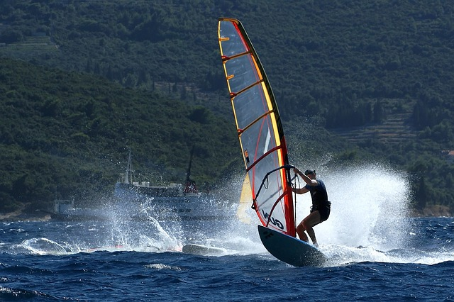
positive face: need to be accepted/liked, to be treated as a member of the same group, to know that wants are shared by others.
negative face: need to be independent, to have freedom of action, not be imposed on by others
Photo by Free-Photoss llicensed CC0
Photo by PublicDomainPictures / licensed CC0

Slide 21
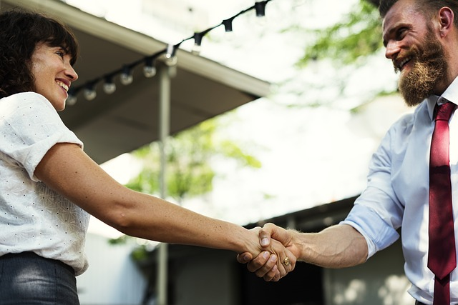
Face and interaction
Intercultural situations are sites for potential ‘loss of face’
=> ‘face work’ must be a part of talk if ‘loss of face’ is to be avoided and co-operation is to be maintained.
Photo by RawPixel / licensed CC0

Slide 22
Negative politeness
Avoids imposition
Respects the other’s need for freedom of action and independence
Tends to show deference, emphasises the importance of the other's time or concerns, and may include an apology for the imposition
*hedge/hedging is one technique of negative politeness - the use of words or phrases that express a degree of qualification or uncertainty, e.g. sort of, kind of, perhaps

Slide 23
Negative politeness – expressions and features
Modal verbs
Apologies for the imposition
Hesitations
Questions (even asking for permission to ask a question)
+ more indirect approach softens refusal
Examples:
Apology: sorry (It was an accident.)
» Apology-acceptance: that’s ok (Not important)
Request: if you can/could you please..? (It’s up to you.)
» Request-acceptance: yes (I’m willing.)
Gratitude (offer-acceptance): thanks (You didn‘t have to do it.)
=> Deference strategy
Notes:
Optional examples (for advisers)

Slide 24
Positive politeness
Supports/ enhances participant’s positive face
Attends to the need of being part of the group, of being accepted and liked
Will tend to show solidarity, emphasise that both speakers want the same thing and have a common goal

Slide 25
Positive politeness – expressions
Greeting: hello (We have a relation.)
Farewell: see you later (We still have one)
Hedged criticism: if you don’t mind me saying so (I won’t damage our relation)
Address: mate (We’re in this together.)
Hidden disagreement: I’ll think about it (Japanese) (I don’t want to offend you.)
Hidden telling: isn’t it? (You’re the expert.)
=> Solidarity strategy
Notes:
Optional examples (for advisers)

Slide 26
Which strategy, do you think, is more common in most English-speaking contexts?
Have you experienced a culture where this is different?
Notes:
Advisers: adapt to your language situation

Slide 27
Face Threatening Acts (FTA)
when a person says something that represents a threat to another individual's expectations regarding self-image (Yule 1996: 61)
Notes:
Optional for advisors, can also be communicated without the slides
Before: Some speech acts are able to damage another person’s reputation/ threaten other people’s face.
Two kinds of FTAs:
» threatening your negative face
» threatening your positive face

Slide 28
Positive FTAs
An act that threatens the need to be accepted/liked/treated as member of same group
E.g. disapproval, criticism, complaints, accusations, contradictions, disagreements
E.g. Criticism: “I don’t think your report was concise enough.” –
The hearer’s positive face is threatened because s/he is blamed for having done something badly, i.e. his/her self-image is negatively evaluated.
Notes:
Optional (for advisors, can also be communicated without the slides)

Slide 29
Negative FTAs
An act that threatens the need to be independent/have freedom of action/not be imposed on
orders/requests, suggestions/advice, reminding, threats/warnings/dares
offers/promises,
compliments, expressions of emotions
E.g. Order: “Please give me that book.”
The speaker expresses an anticipation of some future action of the hearer and thereby restricts his/her personal freedom.
Notes:
Optional (for advisors, can also be communicated without the slides)

Slide 30
ii) Other politeness theories
Brown & Levinson’s (1987) have been criticised for their theory for being too much centred on Western ways of communication
For example: Face theory sees people as individuals more than as social beings => independence (see negative face) and individual needs and feelings are in the foreground, which is a feature of Western cultures, while in other cultures, public images and the community as an evaluator of one’s needs is more important => keeping and losing face/honour in front of the (local) community in Chinese and Japanese cultures is far more important (see Mao 1994)
Also: According to face theory, by being polite and constantly attending to other people’s faces we tend to lose our own face (by apologising, requesting, etc.) => other cultures may see it as more important to look after one’s own face (Chen 2001)

Slide 31
Newer theories aim to be inclusive of other cultures (e.g. Leech 2005; Al-Duleimi et al., 2016):
There are no universals (principles of politeness are not the same everywhere)
But there are also no absolute differences (there is no absolute divide between the ”individualist, egalitarian West” and the “collective, group culture East”)
There are scales of differences, both group and individual values need to be respected
Grand Strategy of Politeness (Leech 2005): In order to be polite, we express/imply meaning that places a higher value on the addressee and a lower value on ourselves

Slide 32
Of course we are not always polite (moods, social situation, impoliteness expressed in irony, etc.)
We use scales to assess the appropriate degree of politeness
Vertical distance between speaker and hearer
Horizontal distance (degree of intimacy, familiarity, solidarity, deference)
Weight and value (social distinction attached to what is transacted)
Strength of socially-defined rights and obligations attached to different roles (guest, host, teacher, student)
Self-territory and other-territory (membership in in-group or out-group)

Slide 33
Invitation
Acceptance
Denial
Notes:
Advisers: make students think, for example, about different cultural ways to react in an appropriate way to an invitation using the scales on the previous slide; similarly: offers, permissions, requests

Slide 34
Example
A: You coming down early?
B: Well, I got a lot of things to do before getting cleared tomorrow. I don’t know. I w- probably won’t be too early.
P: How about going out for a drink tonight?
R: (0.2) tuh-uh sorry b’d I can’ make it = c’z Jill has invited some’ve her friends over. Perhaps some other time.
Notes:
Optional (for advisers): think about other, cultural ways of declining an invitation, how do they come across?

Slide 35
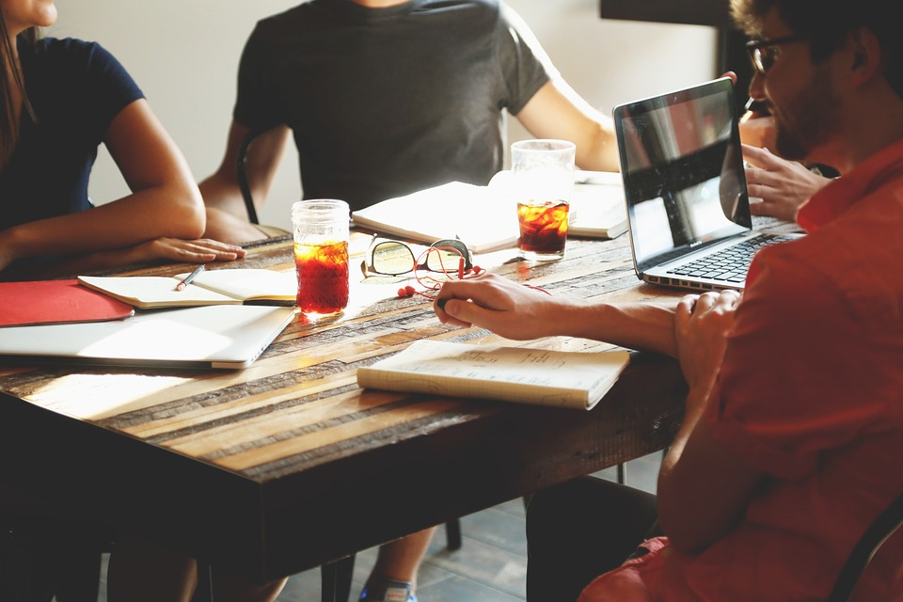
c) Language and Politeness
Photo by StartupStockPhotos / licensed CC0
Notes:
This part intends to make students think about and make them sensitive for how different aspects of language are handled differently indifferent cultures

Slide 36
Contrast: Greeks and Germans telephone conversations
Pavlidou (2000) examined telephone conversations in Greek and German and found marked differences in the way Greeks and Germans manage each of the three sections of a telephone conversation, i.e., opening, main topic, closing:
Greeks usually answer the phone with utterances like ne ('yes'), while it is more typical in German telephone calls for the answerer to identify himself/herself with his/her last name.
Greeks seem to enter into quite a lengthy opening sequence, whereas Germans come to the point of their call much faster.
Greeks use more phatic sequences in both social and transactional calls than Germans do.
Greek closing sequences can be expected to be longer than German ones.

Slide 37
Activity
Watch this meeting clip
Where might we encounter differences in an intercultural communication situation?
Notes:
Advisers: find a intercultural meeting clip that can get students to think about different aspects of communication in the conversation that are handled differently in different cultures; if more ideas are needed, use the following slides

Slide 38
When to talk
Silence can be highly valued.
Some cultures believe it is inappropriate to talk to strangers.
Familiarity vs. chance and amount of talk.
Some don’t talk when expected to by other groups.
Stereotype of ‘other’
Talking ‘other’
Quiet ‘other’
Notes:
Optional (for advisers)

Slide 39
2. What to say
Some cultures never ask the question ‘why’.
Some cultures rarely ask questions.
Talk and learn through story telling.
(Not) Talking about personal experience or emotional involvement
Downplaying and upgrading utterance
Notes:
Optional (for advisers)

Slide 40
3. Pacing and pausing
Speed rate
Waiting to make sure that the previous speaker has finished, before taking one’s own turn to speak
Waiting for a moment between turns
Notes:
Optional (for advisers)

Slide 41
4. Listenership
Eye gaze used and broken by speaker and listener
Steady eye contact during the talk
Showing attention and encouragement
Notes:
Optional (for advisers)

Slide 42
5. Intonation
Intention and Interpretation
Rudeness
Stereotyping
Notes:
Optional (for advisers)

Slide 43
6. Formulaicity and poetic usage
Frequency
Meaning
Cultural context
Notes:
Optional (for advisers)

Slide 44
7. Indirectness
“Ideally, people should say what they mean and people should be accountable only for what they say in words”.
Straight to the point
Necessity of small talk
Never-say-NO talk
Notes:
Optional (for advisers)

Slide 45
8. Cohesion and coherence
Repetition
Syntactic position of main point
Location of new information and old information
Notes:
Optional (for advisers)

Slide 46
Interpretation and meta-communication
In different societies, and different communities, people speak differently, in a profound and systematic way,
Therefore we need to learn how to..
reflect on our own communicative ways
interpret other people’s behaviour
master difficult situations by communicating and acting in an appropriate way in the other culture

Slide 47
Traits that correlate with effective intercultural interaction
Tolerance to ambiguity, don’t avoid uncertain situations
Suspend judgement
Be open-minded and flexible

Slide 48
Simulation Game

Slide 49
Step 4: Questions
If you could describe the game in one word, what would it be?
When did you realise that something was wrong?
How did you deal with it?
What word best describes your feelings during this game?
What specific real-life situations does this game remind you of?
Choose one of these real-life situations.
What are the underlying causes of the problems or difficulties?
What does the game suggest about what to do when you are in a similar situation in the real world?
What did you do during the game that "worked" for you?

Slide 50
Step 5: Meta-communication…
may be expressed directly in speech by such means as ‘I’m only joking’, ‘This is serious’, ‘When I say X, I mean Y’, ‘This is only gossip, but ______’, ‘I heard that _______’, ‘I’m speaking to you as a friend’, and so on, but it is more often expressed indirectly by such things as tone of voice, intonation, gesture, posture, and facial expression. It is largely a matter of how something is said rather than what is said, or colloquially, ‘It’s not what he said but how he said it’. The conceptual content of the message — what is said — is subordinated to what is evoked, revealed, or expressed in the manner of saying. (Tyler, 1978: 408)

Slide 51
References
Al-Duleimi, H. Y. (2016). A Critical Review of Prominent Theories of Politeness. Advances in Language and Literary Studies 7(6), 262-270.
Brown, P., and Levinson, S. (1987). Politeness: Some Universals in Language Use. Cambridge: Cambridge University Press.
Chen, R. (2001). Self-politeness: a proposal. Journal of Pragmatics 33, 87-106.
Eelen, G. (2001). Critique of Politeness Theories. St. Jerome Press, Manchester.
Leech, G. (2005). Politeness: is there an East-West divide. Journal of Foreign Languages, 6(3).
Mao, R. (1994). Beyond politeness theory: ‘‘face’’ revisited and renewed. Journal of Pragmatics, 21(5), 451-486.
Pavlidou, T.-S. (2000). Telephone conversations in Greek and German: Attending to the relationship aspect of communication. In H. Spencer-Oatey (Ed.), Culturally speaking - Managing rapport through talk across cultures (pp. 122-142). London: Continuum.
Tyler, S. A. (1978). The Said and the Unsaid: Mind, Meaning and Culture. New York: Academic Press.
Wierzbicka, A. (2003). Cross-Cultural Pragmatics: The Semantics of Human Interaction (2nd ed.). Berlin/New York: Mouton de Gruyter.
Yule, G. (1996). The Study of Language. Cambridge: Cambridge University Press.

