Slide 1
Unit 2
Intercultural Competence Here and Now
Image by John Baker on Unsplash licensed by Unsplash

Slide 2
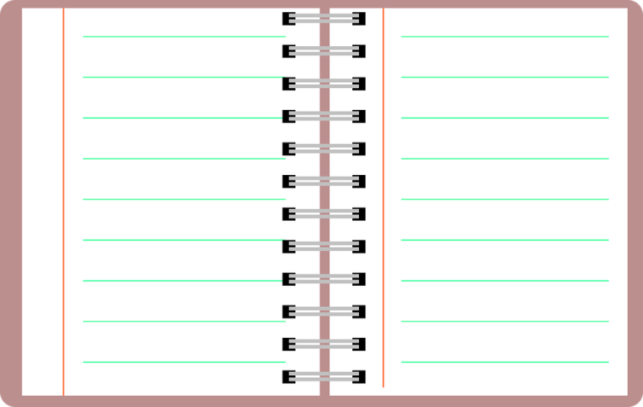
Agenda
Learning goals
Mental games: looking at my own world with different eyes
Global megatrends and the cosmopolitan view
“Localising” our cosmopolitan commitment
A “gallery of statements” to engage in the global dialog
Wrap-up: Scrabble
Image by OpenClipart-Vectors on Pixabay licensed by CC0

Slide 3
1. Learning goals
At the end of this unit you will:
…be aware of diversity in your daily environment.
…be able to critically analyse how and to what extent megatrends shape society.
…be able to apply the diversity perspective on specific scenarios.
…be able to reflect on your role in a complex and interconnected world.
Image by Quince Media on Pixabay licensed by CC0

Slide 4
2. Mental games
Divide into three groups.
Every group selects one mental game.
Your task is to describe with a certain level of detail how the hypothetical world proposed in the game would look.
Image by GDJ on Pixabay licensed by CC0

Slide 5
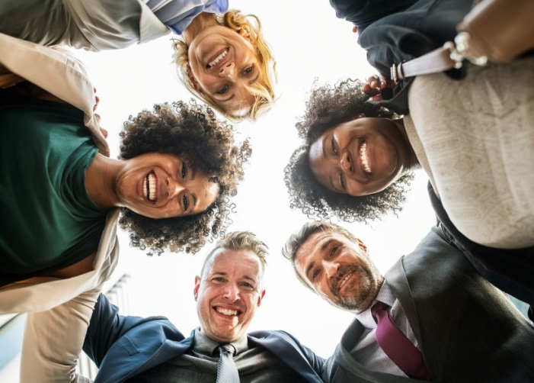
Mental games
Game 1: The proportional country
Imagine that a new set of laws is approved in your country, according to which:
Foreigners are allowed to vote and be elected for the parliament.
The parliament and the body of civil servants have to be proportionally related to the population, so that minorities (for example immigrants) and social groups (for example men and women) have to be proportionally represented in those institutions.
Image by rawpixel on Unsplash licensed by Unsplash
How different would your country be compared to now?

Slide 6
Mental games
Game 2: The Babel Fish
The Babel Fish described by Douglas Adams in The hitchhiker’s guide to the Galaxy* has been discovered and bred, so that nowadays everybody has one. if you stick a Babel Fish in your ear, you can instantly understand anything said to you in any form of language.
Now, people are encouraged to use their mother tongue and to express themselves freely.
How different would your university or institution, neighbourhood or city be compared to now?
How many languages could you listen to around you?
Who would have now more opportunities to speak and be listened to?
Image by Rene Vincit on Unsplash licensed by Unsplash
*(See: http://hitchhikers.wikia.com/wiki/Babel_Fish)

Slide 7
Mental games
Game 3: Switching identities
Rekall Enterprises (the travel memory company of Total Recall*) have just created a new experience based on a device called Identity Switcher. With the Identity Switcher in your pocket, you can exchange your cultural identity with every person you touch (e.g. shaking hands or unnoticed contact in the train) for 24 hours. You love new technology, so you buy the switcher.
How many different cultural identities would you experience in one week?
Which ones would you experience more surely?
To which extent would this experience change you?
What would happen if many other people in your surroundings buy the device too?
Image by geralt on Pixabay licensed by CC0
*(Paul Verhoeven, 1990)

Slide 8
3. Global megatrends and the cosmopolitan view
We may not realise it in its whole dimension, but the world has changed dramatically in recent decades.
The multiculturalisation and diversification of your environment is only one sign of this.
The Finnish innovation fund SITRA summarized current megatrends in the following video.
Image by Meditations on Pixabay licensed by CC0
Megatrend: “[…] global, sustained and macroeconomic forces of development that impact business, economy, society, cultures and personal lives, thereby defining our future world and its increasing pace of change”. (Singh 2012: 4)

Slide 9
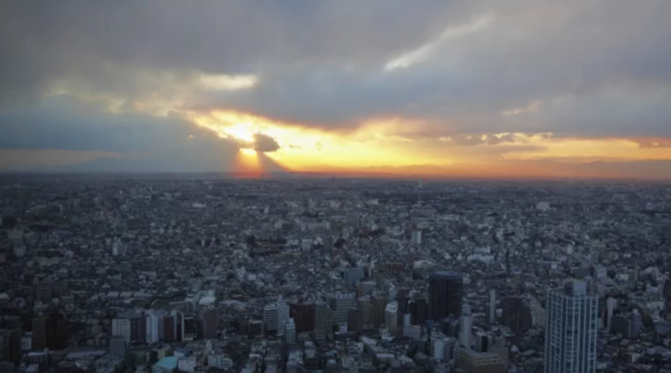
Global megatrends and the cosmopolitan view
SITRA Fund: Megatrends 2016, <https://www.youtube.com/watch?v=FuZWNDF8D-M>

Slide 10
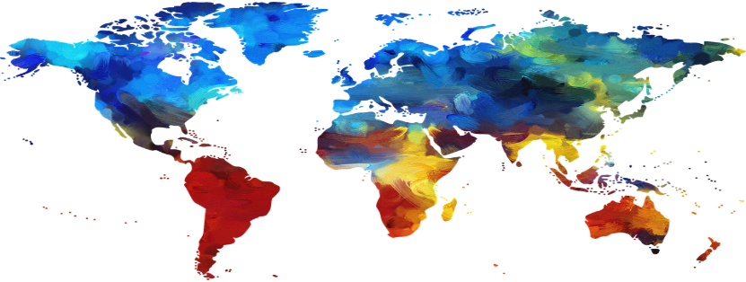
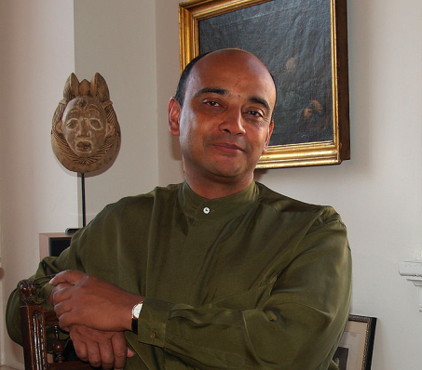
Global megatrends and the cosmopolitan view
Resource scarcity
Changing demographics
Globalisation
Global technological change
Image by fxxu on Pixabay licensed by CC0
What is your experience in relation to these processes?
What is your role in this scenario?
Do we need a different attitude to confront these challenges?
Please watch this short video with Appiah’s proposal to adopt a cosmopolitan view.
Kwame Anthony Appiah
Since 2014: Professor at New York University
Image by David Shankbone on Wikimedia licensed by CC BY-SA 3.0 (cut out)

Slide 11
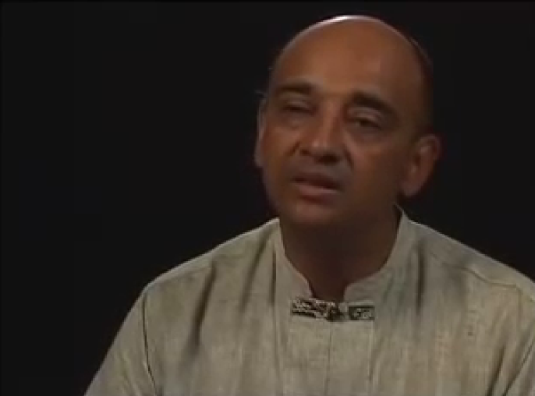
Global megatrends and the cosmopolitan view
(Source: Carnegie Council for Ethics in International Affairs (2012): Thought Leader Kwame Anthony Appiah on Cosmopolitanism, <https://www.youtube.com/watch?v=inyq_tfm8jc>)

Slide 12
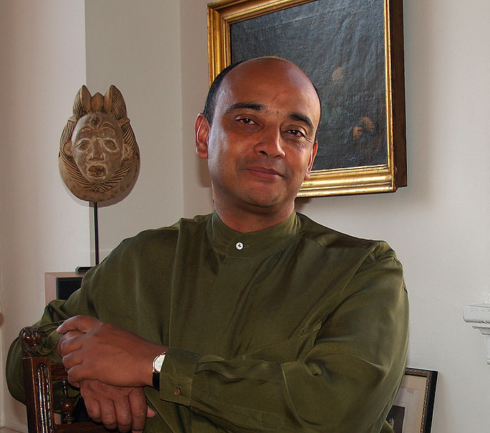
Global megatrends and the cosmopolitan view
Let’s try to summarise Appiah’s main ideas about cosmopolitanism:
…
…
…
…
…
…
Image by David Shankbone on Wikimedia licensed by CC BY-SA 3.0 (cut out)

Slide 13
Global megatrends and the cosmopolitan view
What can be answers of the cosmopolitan view to the global megatrends?
We do have responsibilities – The boundary of your state is not the boundary of your moral concern.
Recognition of the existence of forms of difference that should be allowed to persist.
Participate in the global moral conversation and draw other people in.
Liberal toleration at home as well as overseas – We can agree and disagree about a lot of things.
Resource scarcity
Changing demographics
Globalisation
Global technological change

Slide 14
4. “Localising” our cosmopolitan commitment
Elaborate a chart representing your cosmopolitan commitment to answer global megatrends in your everyday environment.
Specifically address attitudes and behaviour, and match them with experiences and competences that you acquired during your semester or stay abroad.
(Have a look at the example in next slide).
Present your results.
Image by Tero Vesalainen on Pixabay licensed by CC0

Slide 15
“Localising” our cosmopolitan commitment
Megatrend: Changing demographics
A increasing number of refugees and asylum seekers arrived to my town in the last years.
Commitment
I can get engaged in different ways (e.g. as an interpreter, as a language teacher, supporting in the dialog with institutions or in the building of social ties). I can get in touch with local associations working in the field of integration and inform myself about possible forms of participation.
Learnings from my stay abroad
I know what does mean to be new in a place, without enough knowledge of the local language, social practices and organisational structures.
You
Image by OpenClipart-Vectors on Pixabay licensed by CC0

Slide 16
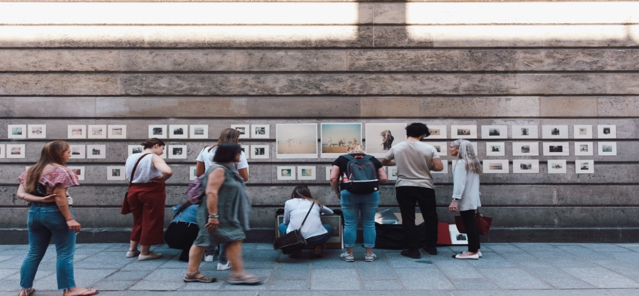
5. A “gallery of statements”
We have prepared a exposition in the form of a “gallery of statements”.
Take your pen and walk around the room in pairs reading the statements by (more or less) famous people about topics related to our megatrends.
Discuss them critically from a cosmopolitan point of view and leave your comments of agreement or disagreement.
You can have a look at the name of the author of every sentence after you have discussed it. Please remember to cover it again.
Image by Tania Shevereva on Pixabay licensed by CC0

Slide 17
6. Wrap-up: Scrabble
Play scrabble on the whiteboard.
Every participant writes a key world from this unit crossing it with another existing word.
After having written it, he/she explains why this concept is important for him/her.
(own image)

Slide 18
Bibliography
Singh, Sarwant (2012): New Mega Trends: Implications for our Future Lives, New York, Palgrave Macmillan
Appiah, Kwame Anthony (2007): Cosmopolitanism: Ethics in a World of Strangers, New York, Norton.
Image by Clker-Free-Vector-Images on Pixabay licensed by CC0

