Slide 1
Connect • Mentors‘ Training • April 25-29, 2018 • Hamburg, Germany
Funding

Slide 2
Funding ≠ money!
Connect • Mentors‘ Training • April 25-29, 2018 • Hamburg, Germany
„Fundraising“ = „gathering resources“
Money is one resource
Resources can also be free of charge: rooms (e.g. at university), potluck dinner (visitors bring food), etc.
Money can come from many different sources
donors
family
friends
sponsors
In-kind donations
(free of charge)
crowd
funding
http://www.mitost.org/editions/initiativecookbook/THK/Cookbook_English/THK-Cookbook_English.pdf

Slide 3
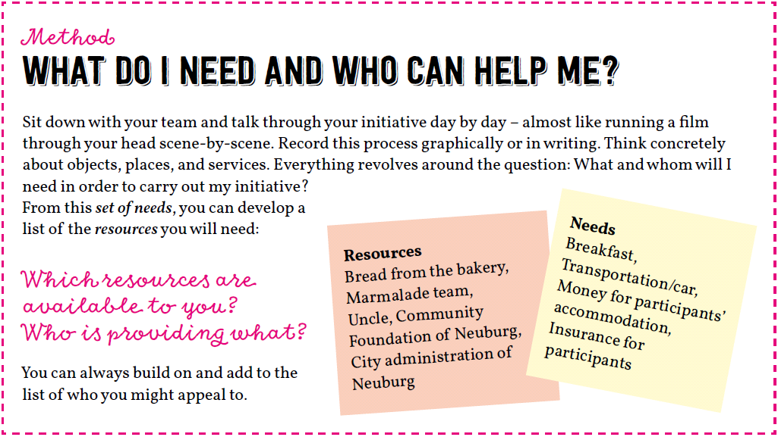
Connect • Mentors‘ Training • April 25-29, 2018 • Hamburg, Germany
http://www.mitost.org/editions/initiativecookbook/THK/Cookbook_English/THK-Cookbook_English.pdf

Slide 4
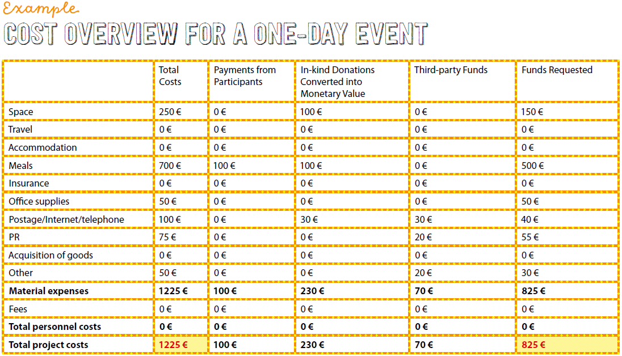
Connect • Mentors‘ Training • April 25-29, 2018 • Hamburg, Germany
http://www.mitost.org/editions/initiativecookbook/THK/Cookbook_English/THK-Cookbook_English.pdf

Slide 5
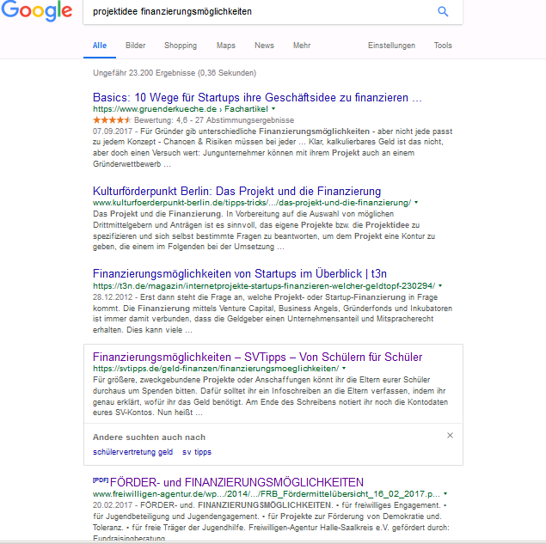
Connect • Mentors‘ Training • April 25-29, 2018 • Hamburg, Germany
85 development
funding opportunities
https://www.google.de/search?source=hp&ei=b3fZWpr6GYrVwQLnhqxY&q=projektidee+finanzierungsm%C3%B6glichkeiten&oq=projektidee+finanzierungsm%C3%B6glichkeiten&gs_l=psy-ab.3...352.8017.0.8899.40.40.0.0.0.0.180.4181.22j18.40.0....0...1.1.64.psy-ab..0.39.4031...0j0i131k1j0i10k1j0i22i30k1j0i22i10i30k1j33i160k1j0i13k1j0i13i30k1j0i13i5i30k1.0.f5z8XONiWF4

Slide 6
Applying for financial support
Connect • Mentors‘ Training • April 25-29, 2018 • Hamburg, Germany
municipality, city, administrative districts, states, EU, UN
associations, foundations, governments (foreign office, embassies)
companies, banks
DIFFERENT OPPORTUNITIES IN EACH COUNTRY / REGION
universities, schools, clubs

Slide 7
Good to know
Connect • Mentors‘ Training • April 25-29, 2018 • Hamburg, Germany
European programmes
ERASMUS+
http://ec.europa.eu/programmes/erasmus-plus/node_en

Slide 8
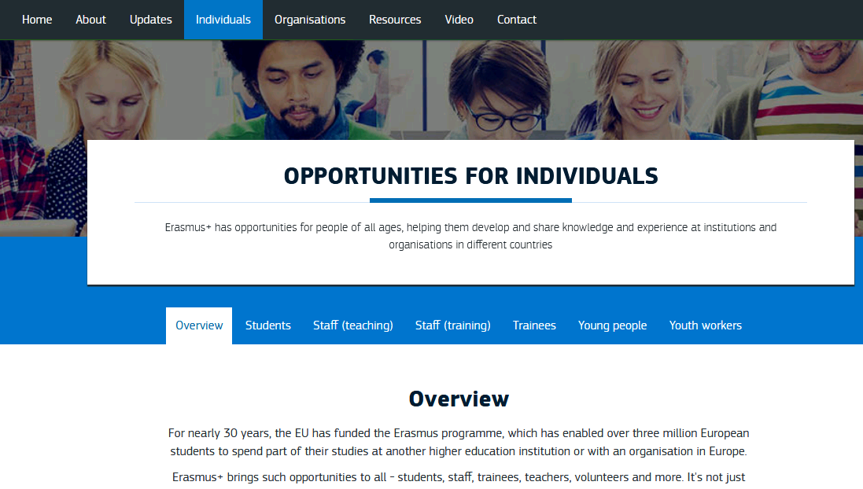
Good to know
Connect • Mentors‘ Training • April 25-29, 2018 • Hamburg, Germany
ERASMUS+
http://ec.europa.eu/programmes/erasmus-plus/individuals_en

Slide 9
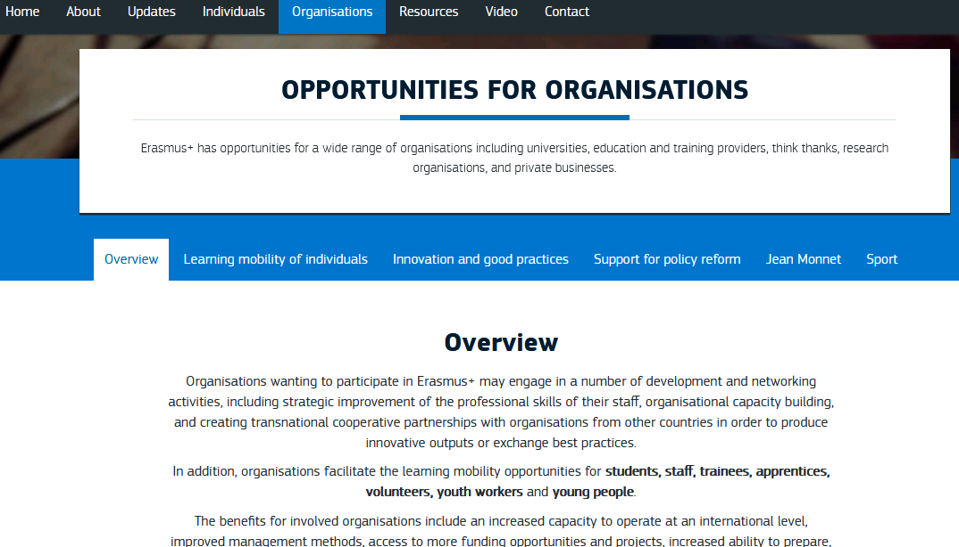
Good to know
Connect • Mentors‘ Training • April 25-29, 2018 • Hamburg, Germany
Key Action 2: Innovation and good practices
Strategic partnerships in the field of education, training, and youth
TRANSNATIONAL YOUTH INITIATIVES
http://ec.europa.eu/programmes/erasmus-plus/organisations_en

Slide 10
Connect • Mentors‘ Training • April 25-29, 2018 • Hamburg, Germany
Up to 60.000 € and more
p. 130
https://ec.europa.eu/programmes/erasmus-plus/sites/erasmusplus/files/files/resources/erasmus-plus-programme-guide_en.pdf

Slide 11
Good to know
Connect • Mentors‘ Training • April 25-29, 2018 • Hamburg, Germany
European programmes
ERASMUS+
http://ec.europa.eu/programmes/erasmus-plus/node_en
European Youth Foundation by Council of Europe
https://fej.coe.int/

Slide 12
What ideas do you have?
Connect • Mentors‘ Training • October 25-29, 2017 • Limerick, Ireland
think small…
Notes:
Kuchen verkaufen, selbstgemachte Marmelade
Flohmarkt (Bücher, Kleidung)
Eintüten im Supermarkt
Geld zum Geburtstag
Firmen: car companies, google, Deutsche Bahn
Blut spenden
Tür zu Tür
Spendenlauf
Promis
…

