Slide 1
Marketing
and
Public Relations

Slide 2
http://www.the-cartoonist.com/vault/otl2/richdiesslin_wienerdog_sign.jpg
Notes:
We are not PR experts, we are not going to talk about differences between PR, marketing, advertisement (you can google it), we are not going to go through PR definitions… After you have learned something about communication, about how to come up with project ideas and what questions to follow, after you have pitched ideas and designed flipcharts, we want to look a bit at PR/advertisement and the question “what to keep in mind to attract people’s attention”. You will not be PR experts after this workshop as some people study many years to get into marketing, social media PR, etc. And as it is late in the afternoon, after a full day, we also want to give you the chance to go outside and get some fresh air – with a task ;)
But before this: Who can recall any advertisement that has caught his/her attention lately. Briefly explain why/what attracted you.
I am going to show you some campaigns, movements, products or brands now. After each one I’ll ask you to give a show of hands whether you know or have heard of the respective brand, organization, product, etc. and if you have a picture of the initiating organization, company, group of people in mind. By “picture” I don’t just mean y their reputation, but also what kind of people would like to be involved in the campaign, who sell this product, who wouldn’t and so on? Maybe it’s not completely clear yet, I’m sure it will get clear soon. Let’s get started…

Slide 3
#notmypresident
Notes:
Bei dieser Übung macht es dann natürlich Sinn, spontan auf die Rückmeldung der Zuhörenden zu reagieren
Show of hands
1) Who has heard of this?
2) Who has an idea or a picture in their head what kind of people use this hashtag?
Fascinating, right? There are no names, no country is managed, but nevertheless most of us know who is criticized by this hashtag
(#NotMyPresident is a social media activist movement protesting the election of Donald Trump as the 45th President of the United States.)

Slide 4
Notes:
Show of hands
1) Who knows this logo?
2) If you don’t know the logo, what do you think is it about? (Why do you know?)
(NOH8 is a charity organization. Its aim is to promote gender equality, equality in marriage (LGBTQIA marriage), as well as equality as a human right through education, lobbying, internet media and visual protest.
NOH8 ist ein Wohltätigkeitsverein, welcher es sich zum Ziel gesetzt hat, Gleichheit für Geschlechter, in der Ehe, sowie als Menschenrecht durch Bildung, Interessenvertretung, Internetmedien und sichtbaren Protest voranzutreiben.)

Slide 5
Notes:
Show of hands
1) Who knows this symbol?
(The Olympic rings are the official symbol of the Olympic Games. The rings represent the union of the five continents and the meeting of athletes from around the world at the Olympic Games. The rings were first used at the Olympic Games Belgium in 1920.)

Slide 6
Notes:
Show of hands
1) Who knows this organization?
2) When you see completely identical donation appeals, except that one has this logo on it and the other a logo you don’t know, would it be more likely that you donate for the one with this UNHCR logo?
Either way ask yourself: Why??
(The Office of the United Nations High Commissioner for Refugees (UNHCR) is a part of the United Nations. The purpose of this agency is to protect and support refugees when governments or the UN ask for help. The UNHCR helps refugees return home out of their voluntary will, settle locally, or move to a third country [according to the Convention Relating to the Status of Refugees and other international law.])
The United Nations (UN) is an intergovernmental organization to promote international cooperation.

Slide 7
#IceBucketChallenge
Notes:
Show of hands
1) Who has heard of this activity?
2) Who knows what they are aiming to raise awareness for?
Hopefully a lot raise their hands at the first question and less after the second.
For those who do not know: the icebucketchallenge, challenged people to literally dump a bucket full of ice over their head.
It actually was meant to raise awairness for people who suffer from Amyotrophic Lateral Sclerosisa, which is a nerve desease. Besides raising awareness it was also aiming to collect donations for research.
(The Ice Bucket Challenge is an activity involving the dumping of a bucket of ice and water over a person's head, either by another person or self-administered.
-> to promote awareness of the disease amyotrophic lateral sclerosis (also known as motor neurone disease) and encourage donations to research.
-> It went viral on social media during July–August 2014
-> The challenge encourages nominated participants to be filmed having a bucket of ice water poured on their heads and then nominating others to do the same. A common agreement is that nominated participants have 24 hours to comply or lose by way of a charitable financial donation.)
Motor neurone disease (Amyotrophic lateral sclerosis) is a chronic, progressive, almost always fatal neurological disease.^{[1]}
These are the nerve cells which move muscles when we speak, walk, swallow, and move our body. These diseases get worse with time. They cause increasing disability and, eventually, death. There is no known cure. It is marked by slow but steady death of the nerve cells in the central nervous system that control voluntary muscle movement. That is, people can no longer move, but their heart still beats.

Slide 8
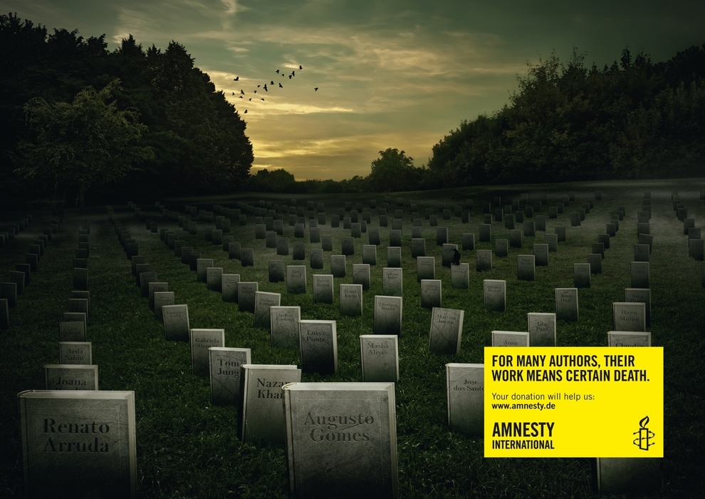
Notes:
As you probably notice I erased the organisation behind this campaign. But anyhow
Show of hands
Who knows which organization is responsible for this campaign?
(Yellow logo -> Amnesty International – TRADEMARK/BRAND LABEL)
(The campaign brings to life the very real risks that novelists, essayists, philosophers and journalists take everyday by just speaking their mind. It is a visually arresting and dramatic defence of free speech)
Amnesty International is an international organization which promotes human rights.

Slide 9
What is the difference between marketing and public relations?

Slide 10
Scavenger hunt
In the next 40‘: In groups, walk around the hostel and/or outside and collect marketing/PR material.
Ideally, walk in different directions to avoid coming back with the same material.
Keep your eyes open: What raises your attention?
Notes:
As you maybe have already notice the next couple of hours are about Public Relation- PR. Because not only what you do influences your degree of familiarity, but also how good you are in letting people know about it. If you want to be active within the next couple of week, months or hopfully years. It is one thing to do it, but the other thing to let people now about what you are doing . Do good, but also Talk about it.
That we are almost constantly are surronded by PR and Advertisment.
Now I want you to look out for it:
Gather in groups of 4/5.
The task is bringing back everything which seems for you like PR or Advertisment.
You can bring back actual flyer or posters, if it is not possible to just bring it with you, no problem make a picture of it. Important is to come back with as much material as possible, with which we can work later.
So that not everyone brings back the same stuff it would make sense that the groups goes in different cardinal points.

Slide 11
https://images.tenplay.com.au/~/media/TV%20Shows/Living%20Room/Marquees/S4/HoN_900x506.jpg

Slide 12
Step 1
All together in 5 minutes:
Sort all material according to
- HOT: good/attractive/appealing/mind-blowing… material
- NOT: bad/unflattering/dull/boring… material
Notes:
Was it easy or hard? Did you have different opinions? Why? Did you maybe come up with an extra category (in-between)? Examples?

Slide 13
Step 2
Divide into two groups:
- HOT-group: What makes this material „hot“ (good/attractive/appealing/mind-blowing…)?
- NOT-group: What makes this material „not hot“ (bad/unflattering/dull/boring…)?
Create a collage! (20 min)
Notes:
Collect/Stick material on a brown paper and note what makes it good or bad next to the flyer or somewhere on the paper.

Slide 14
Conclusion
http://blog.marketwired.com/wp-content/uploads/2015/05/SMGoodPR.jpg
Notes:
When promoting your idea (project, event…) – which rules do you follow to catch the attention of your target group?
-> COLLECT ON FLIPCHART („hot promotion“)

Slide 15
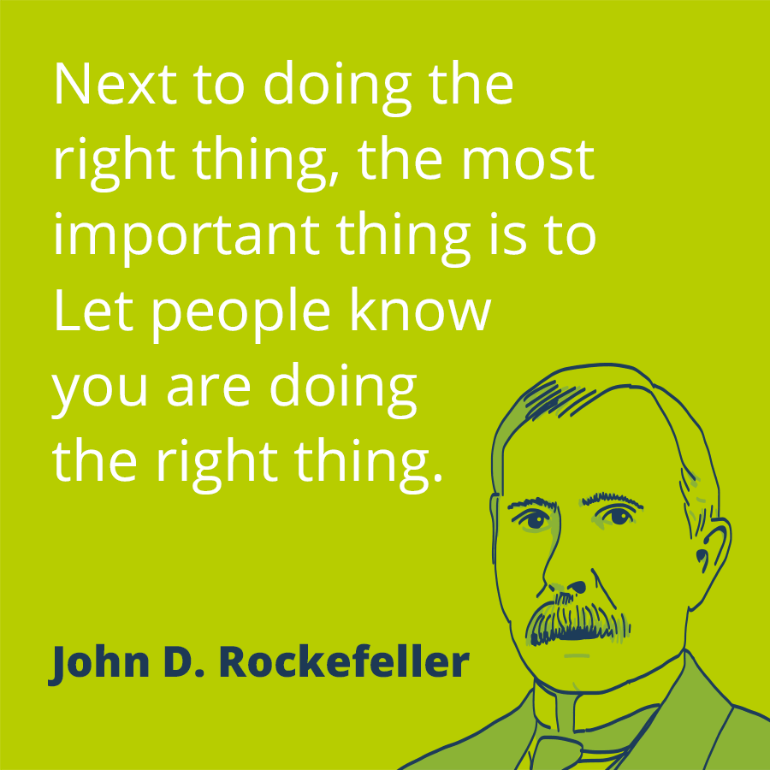
Thank you!
https://www.prezly.com/static/assets/pr-quotes/pr-quote-rockefeller.png
Notes:
Was it easy or hard? Did you have different opinions? Why? Did you maybe come up with an extra category (in-between)? Examples?

